Slide 1
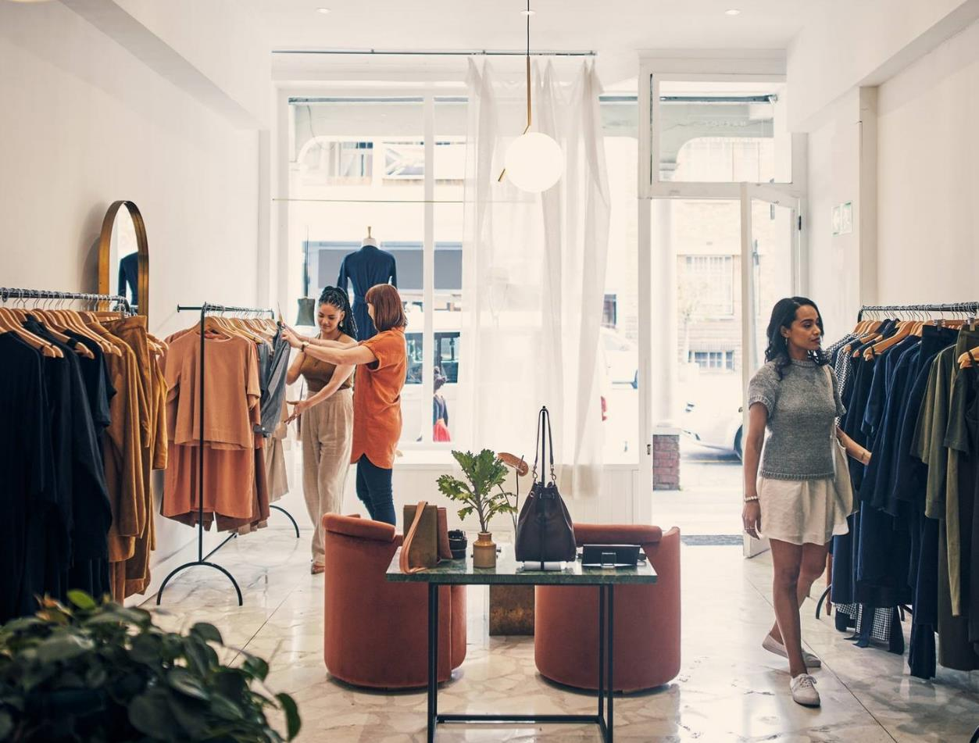
NTV FABRIC
BY
TAMIZHVANI
(Group-3)

Slide 2
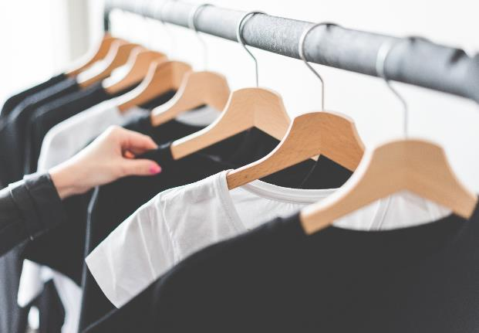
Product overview
Unique
Tested
Only product specifically dedicated to the small retail businesses market
Conducted testing with young entrepreneurs
First to market
Authentic
First beautifully designed product that's both stylish and functional
Designed with the help and input of online retail experts in the field

Slide 3
ONLINE SHOPPING WEBSITE
COMPONENT FILES
CREATED
→HOME.JS
→NAVBAR.JS
→ITEMCARD.JS
→DATA.JS
→CART.JS
STYLING FILES
→ITEMCARD.CSS
→NAVBAR.CSS
REACT JS
(Framework used )
HTML
JS
CSS

Slide 4
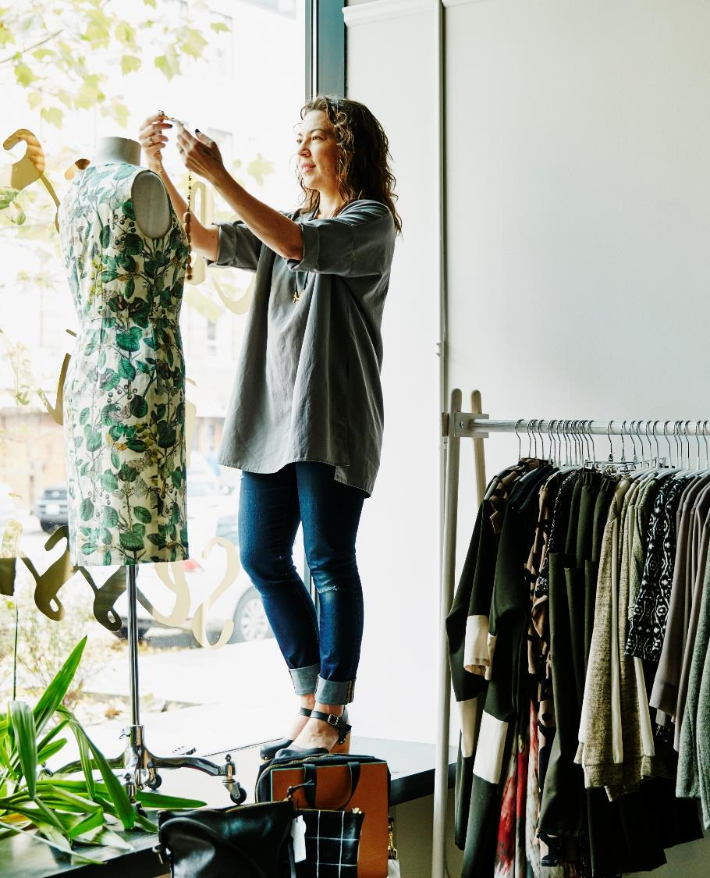
→Imported {Cart provider}
by installing react-use-
cart
→ {ARRAY}=)To fetch the data’s like image and product title, description, and price .

Slide 5
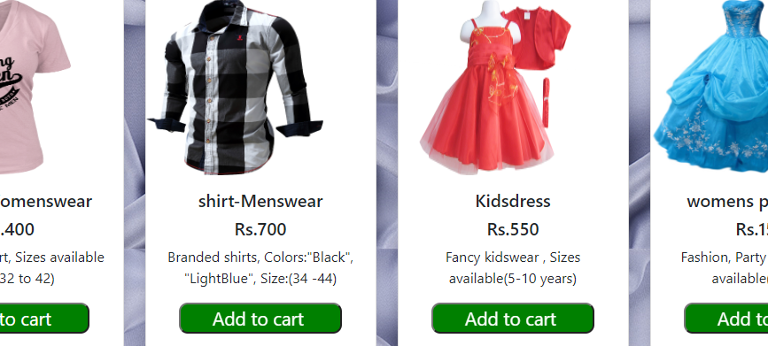
OUTPUT (STEP 1)
LIBRARY INSTALLED→REACT-USE -CART

Slide 6
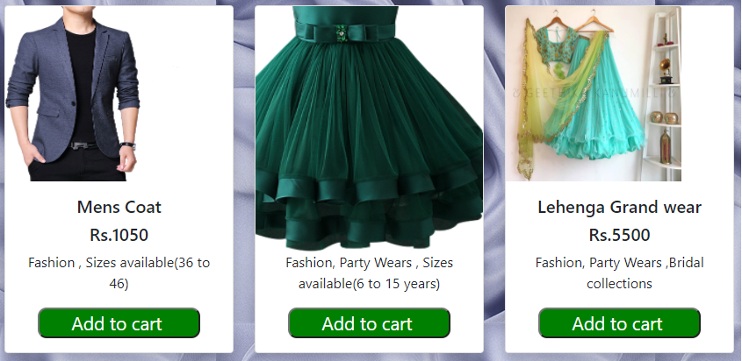
OUTPUT (STEP 2)
HOVER EFFECT APPLIED IN IMAGE

Slide 7
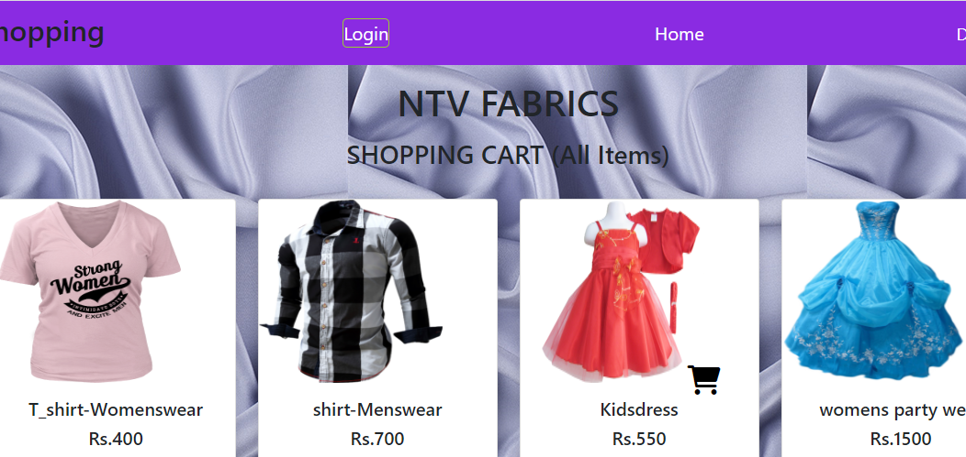
OUTPUT (STEP 3)
ANIMATION OF CART WHEN CLICK
ON ADD TO CART BUTTON

Slide 8
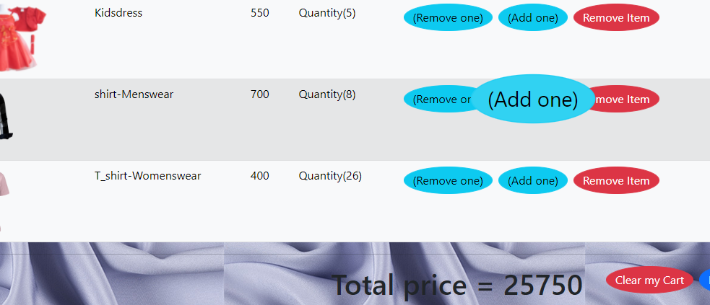
CART OUTPUT
HOVER EFFECT
BUTTON

Slide 9
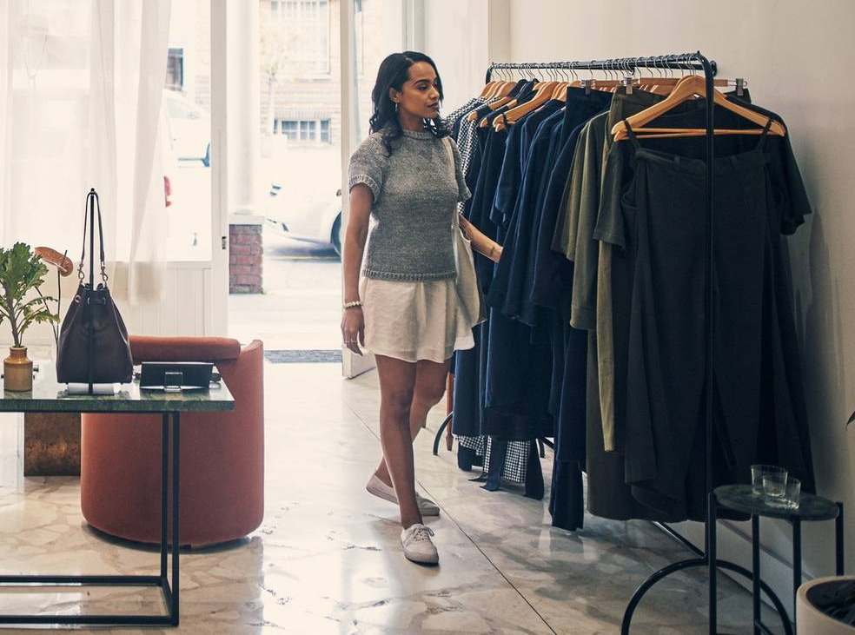
Thank you
044-22232425
ntvfabric@gmail.com
www.ntvfabric.com

